Slide 1
Essential Behavior Principles for Classroom Success
Brian King, PhD
Buddy D. Alger, Ed.S

Slide 2
Why is good classroom management important?
Significant loss of instructional time
19% of teachers report losing 2-3 hours weekly
17% of teachers report losing 4 hours or more weekly
(Walker, Ramsey, & Gresham, 2004)
Targeting on-task behavior leads to improvements in academic achievement and decreases in problem behavior
(Wood et al., 1998)
On-task and problem behaviors are incompatible
(Ducharme & Schecter, 2011)
Behaviors “spillover”
(Greenwood, Horton, Utley, 2002)

Slide 3
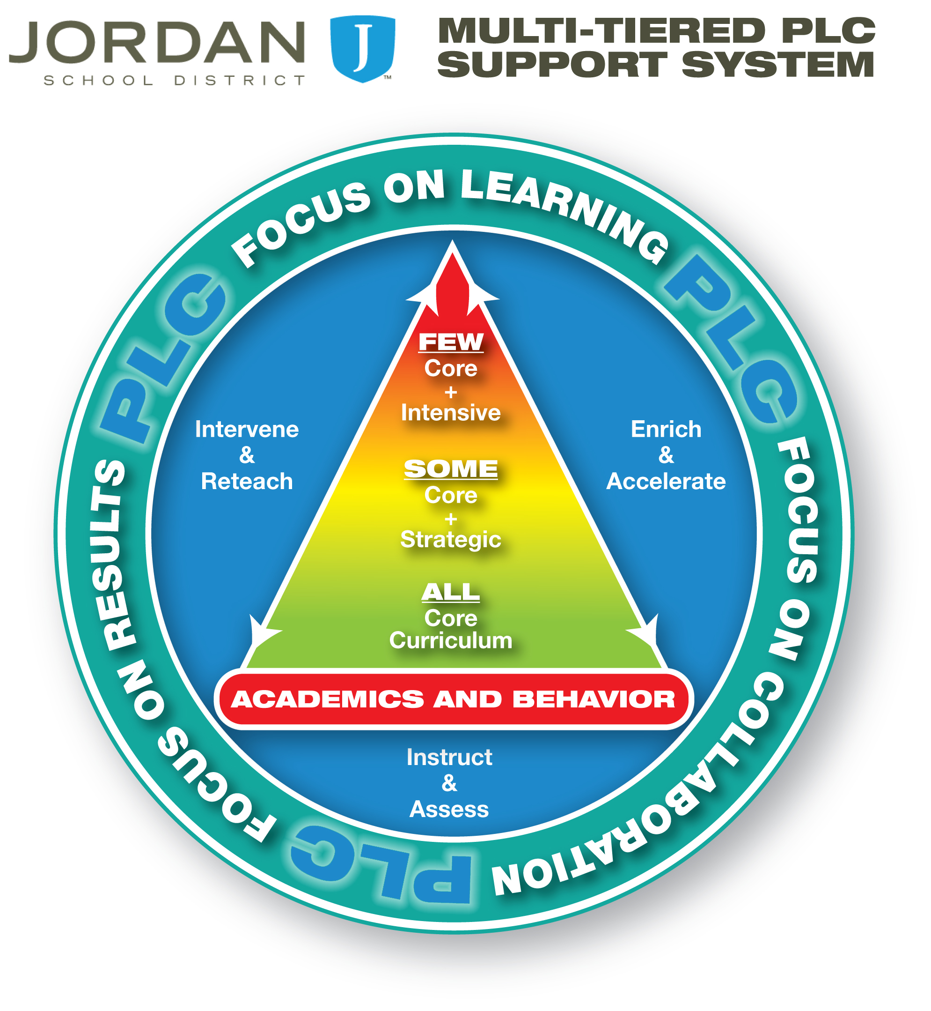

Slide 4
Behavior ABCs
Antecedent
What happens before a behavior
Makes the behaviors more/less likely to occur
Behavior
What the student does
Behavior excess / behavior deficits
Consequence
What happens afterward
Positive or negative

Slide 5
Antecedents
“An ounce of prevention is worth a pound of cure.”
Examples
Predictability
Task difficulty
Effective instruction
Seating
Student interest
(Kern & Clements, 2007)

Slide 6
Antecedents
A few antecedents that make all the difference
Rules
Routines
Requests

Slide 7
Classroom Rules
Should be only a few
Straightforward and simple
Behaviors that are observable and measurable
Be positively stated
Important behaviors only
Posted in a prominent place

Slide 8
Classroom Rules
A good set of rules may include:
A compliance rule
A preparation rule
A talking rule
A classroom behavior rule
An “on-time” rule

Slide 9
Look over the following rules with a partner:
Listen to the Teacher
No Talk-Outs
Be Respectful
Stay in Your Own Space
Keep Your Dear Teacher Happy
Are changes needed?
How could you make these rules more effective?
Notes:
3 minutes (2 to process)

Slide 10
Classroom Rules
Follow adult direction Keep hands, feet, and object to yourself Follow the Red/Green sign Be in your seat unless you have permission to leave it Work when you’re supposed to

Slide 11
Classroom Rules
Rules need to be taught!
Describe and demonstrate exactly what you mean
Provide opportunities for practice
Give encouragement, feedback, prompts, and reinforcement
Teach and rehearse over several days, and do booster sessions once in a while

Slide 12
Class Rules
Rules need to be taught!
Doctors were surveyed and asked how often, compared to what they should, do they wash their hands?
Self-report data was….
74%

Slide 13
Class Rules
9%
Nurses reported:

Slide 14
Red / Green Sign
Step 1: Glue one green and one red piece of paper together
Step 2: Red means no talking unless you raise your hand and are called on.
Step 3: Green means the class may talk quietly
Explicitly teach what “quietly” looks like
12 inch whisper

Slide 15
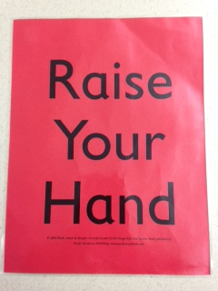

Slide 16
Classroom Routines
Routines need to be taught too
Coming into class
Leaving class
Transition from
task to task

Slide 17
Classroom Schedule
“Time not scheduled in a classroom is an open invitation for disruptive behavior.”
(Rhode, Jenson, & Reavis, 2010)
70% of the day must be scheduled for academic activity
The remaining time should be structured as well!
For Example:
4.5 hours elementary
63 minutes of a 90 minute period for secondary
In elementary includes academic time, transitions, recess, and lunch
Strategies such as peer tutoring and cooperative learning can help teachers meet this goal

Slide 18
Authority
If you look the part of someone with authority and knowledge, you are far more likely to get students to comply.
Factors that help a student to identify you as the “authority”:
Good classroom rules
Structured schedule
Proactive behavior management program
Consistency
Professionalism
dress, language, body language, etc.

Slide 19
What is the #1 antecedent to noncompliance?
Teacher Requests

Slide 20
Coercion Chain
Withdraws request or Stops Tantrum
Negotiates
Now you have had it! Tantrums, Aggression
You had better? (Yells) Makes excuses, argues
Come on, Please…. Delays
Wouldn’t you like to________? Ignores
⬆ ⬆
ADULT Child

Slide 21
Variables that affect compliance
Do not use questions
Get close to the student
Eye contact
Allow time to respond (5-10 Seconds)
Specifically describe what you want
Do not nag
Remain calm and unemotional
Recognize and verbally reinforce students when they do as you ask

Slide 22
Precision Requests
1. “Name, direction, please” WAIT 3 - 5 seconds (students with no language delays) WAIT 7 - 10 seconds (students with language delays)
Compliance Non- REINFORCE! Compliance 

Slide 23
Precision Requests
2. “Name, you need to direction.” WAIT 3 - 5 seconds (students with no language delays) WAIT 7 - 10 seconds (students with language delays)
Compliance Non- REINFORCE! Compliance 
Follow Through

Slide 24
Practice using precision requests with a partner for the following scenarios:
A student is running around your classroom with his hands in the air and you would like for him to sit down so that you can talk.
A student has been sent to you classroom for a Think Time. She has been there for a few minutes and has started a riveting conversation with some of your students. She has not started the assigned work that she has brought with her.
A group of students have snuck a football into the cafeteria and are attempting to reenact a play from last night’s big game. A particular student sees you and attempts to hide the football behind his back as you approach.
Notes:
Use Time Timer: 4 minutes for practice, 2 minutes to discuss.

Slide 25
Target Behaviors Needs To Be Reinforced
“Where attention goes, behavior grows!”

Slide 26
Types of Reinforcement
A critical element in effective classroom management is determining the positive reinforcement that will be made available
Reinforcement is always given after the desired behavior NEVER before.

Slide 27
Selecting Your Rewards
Observe (by watching students it is possible to determine what they like).
Survey students (many students will be able to give good ideas)
A teacher should learn to “think” like a student in order to select effective reinforcement.
Reinforcement Menu (teacher has student identify items they would like to earn and places them on a menu.)

Slide 28
Types of Reinforcement
Natural Positive Reinforcement
use of playground equipment, work as a lunch server, pass out papers, help custodian, school dances, assemblies, first in line
Edible Reinforcement
candy, pop, ice cream, one study in indicated the #1 edible reinforcer for 5-12 year olds was French Fries (1980)
Material Reinforcement
new pencil, toys, self-stick tattoos, hackey sack, games ,#1 material reinforcers for 5-12 year olds was stickers (1980)
Social Reinforcement
smile, high five, praise in front of the class, classroom VIP

Slide 29
Arguments Against Positive Reinforcement….That Are Just Not True!
The Bribery Argument
Truth: Bribery is an inducement for an illegal or unethical act….not appropriate behavior
A bribe is given before an act, positive reinforcement is given only after a student displays a target behavior
The Fairness Argument
Truth: Fairness means to provide each student with what she need to have an equal chance for success
The Kills Internal Motivation Argument
Truth: If external rewards are given for behavior that is positively improving, meaningful, and successful, they improve both external and internal motivation
All students (and adults) need legitimate and appropriate reinforcement
The Hooked on Praise Argument
Truth: There is very little evidence that student become overly dependent on praise!
Nothing is more important than positively reinforcing students for appropriate behavior!
Notes:
P. 46

Slide 30
Choose 5-6 reinforcers that can be used for your whole class
If needed, use the provided reinforcer list to help generate some ideas
http://www.online-stopwatch.com/candle-timer/
Notes:
4-5 minutes with timer from stopwatch.com

Slide 31
Systems for Tough Students
Core Assumption
Target students are in a classroom setting with an appropriately implemented basic management system in place
Important because:
Many students exhibit severe behavior problems as a result of ineffective dysfunctional classroom management
The goal with all difficult kids s to sufficiently change their behavior so that ultimately they can be taught effectively using the basic classroom management plan

Slide 33
Class-wide Behavior Management
Group Contingency
A group contingency is a system for the delivery of a contingency to an entire group, based upon the behavior of the individuals in the group.
Encourages students to reinforce each other for following the rules.

Slide 34
Classroom Rules
Follow adult direction Keep hands, feet, and object to yourself Follow the Red/Green sign Be in your seat unless you have permission to leave it Work when you’re supposed to

Slide 35
What If? Chart
Step 1. Make a “What if? Chart” with two columns.
List positive consequences in the left column
List unpleasant consequences in the right column

Slide 36
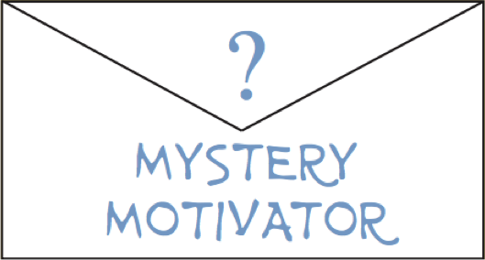
What If? Chart
What if you do? | What If you don’t?
10 minutes of free time Skip an assignment 15 minutes of class music Mystery treat Pride Ticket | Verbal warning Wait 9 seconds after class Wait 39 seconds after class Wait 51 seconds after class Mystery Consequence Box Loss of rewarding activity Seat change Phone call home Serious Behavior Clauses Principal’s office referral Suspension
Notes:
Secondary

Slide 37
What If? Chart
Step 2. Write the rewards on the left side of the chart.
Elementary Students | Secondary Students
Read a story to the class | Listen to the radio (station/volume)
Free time to talk | Free time to talk
View 15 minutes of high-interest movie | Snacks in the class/for the class
Drop a homework assignment | Lottery drawing for a prize
Lottery drawing for a prize | Reward Spinner
Reward Spinner | Chart Move
Chart Move | Drop a homework assignment
Send home a positive note with three random students | Allow students to select seats for a a day
Small Prizes (Oriental Trading Co.) | Send home a positive note with three random students

Slide 38
What If? Chart
Step 3. Add the Mystery Motivator!
A Mystery Motivator is an incentive or reward written on a piece of paper and placed inside an envelope.

Slide 39
“How To” guide for making a Mystery Motivator
Select a reward for the students to earn.
Write the selected reward on a piece of paper and put it in the envelope.
Write a question mark on the envelope and tape the envelope to the bottom of the chart.
Tell the students that there is something you have selected as a reward for following the classroom rules, but you cannot tell them what it is.

Slide 40
What If? Chart
Step 4. Establish a Secret Rules Number to determine criteria for classroom reward
If the number of violations is at or below the secret number, the class earns reward
There are two ways to select the secret number
Teacher selects a random number and writes it down
Write up numbers on 30 pieces of paper with an average of rule violations for your class and place them in a jar. Include a 0, and a 99.

Slide 41
Selecting Reward
1). Tell the class that if their total number of rules violations falls at or below the Secret Rules Number, they can vote for one of the rewards.
2). Write each student’s name on a slip of paper and place all of the papers in a bag. When a class earns reward draw a name out of the bag. Allow that student to choose.

Slide 42
What If? Chart
Reductive or Unpleasant Consequences
Step 5: List the unpleasant consequences on the right side of the chart.
They should be mild, unpleasant, and inconvenient
Consequences are arranged in a hierarchy of increasingly more unpleasant consequences for breaking the rules.
They should not require a lot of time and effort

Slide 43
What If? Chart
What if you do? | What If you don’t?
10 minutes of free time Skip an assignment 15 minutes of class music Mystery treat Pride Ticket | Verbal warning Wait 9 seconds after class Wait 39 seconds after class Wait 51 seconds after class Mystery Consequence Box Loss of rewarding activity Seat change Phone call home Serious Behavior Clauses Principal’s office referral Suspension

Slide 44
Unpleasant Consequences
The worst time to select a reductive or unpleasant consequence is in the midst of arguing, tantrums, or yelling.
Apocalyptic Consequences

Slide 45
Unpleasant Consequences
Reductive consequences are used only if:
Pre-established classroom rules are broken
If a student does not comply with a precision request
If misbehavior occurs that is not addressed in the rules, then the classroom rules should be reexamined.

Slide 46
What If? Chart
Step 6: The first time each day a student breaks a rule, he or she earns the first undesired consequence in the hierarchy. The second time a rule is broken, he or she earns the second one, and the third time the third one.

Slide 47
What If? Chart
Step 7: Use the “Mystery Consequence Box” for the fourth infraction on the What If? Chart.
Write 20 consequences on slips of paper and place them in individual envelopes.
Place envelopes in a box
When a student breaks four rules in one day, require the student to pick an envelope from the box.

Slide 48
What If? Chart
Step 8: A “What If? Chart” hierarchy must also include a serious behavior clause.
Serious misbehaviors include:
Blatant or intensely defiant noncompliance
A continuing physical fight
Illegal drug possession
Carrying a weapon
Physical destruction of property (such as fire setting)

Slide 49
What If? Chart
What if you do? | What If you don’t?
10 minutes of free time Skip an assignment 15 minutes of class music Mystery treat Pride Ticket | Verbal warning Wait 9 seconds after class Wait 39 seconds after class Wait 51 seconds after class Mystery Consequence Box Loss of rewarding activity Seat change Phone call home Serious Behavior Clauses Principal’s office referral Suspension

Slide 50
What If? Chart
Step 9: Keep a “Rule Monitoring Chart” to identify chronic offenders as well as to help determine the class average of rule violations
Use tally marks to identify which rules were broken
Start out with a new one each day
Alternatives
Use back of name badge
Sticky notes / 3x5 Card
Masking tape bracelets

Slide 52
What about Bubba?
There may be a saboteur who sets the whole class up for failure by chronic rule breaking.
About 1-2 per class
Consider your reinforcers
Gather feedback from students
Place students on an individual intervention

Slide 53
Rules Self-Monitoring Program
Explain to the students that when they break a predetermined number of rules or more in a day they will be placed on the rules self-monitoring program. * We recommend 3 to 4
Step 1: Place a Self-Monitoring Classroom Rules form on the student’s desk.
Step 2: On the form, list the rules that the student is consistently breaking.

Slide 54
Rules Self-Monitoring Program
Step 3: Teach the student how to monitor
Step 4: Provide the student with feedback about the accuracy of his or her rating
Don’t argue/negotiate with the student
Step 5: When the student has four ratings with a 3 or above, and you agree, they can move back to the class wide reward system.
A copy of the student’s self-monitoring chart can be used as a Home Note

Slide 56
Individual Interventions
Despite setting up the programs, strategies, and reinforcers that we have talked about up to this point, some of your students may still require additional support.

Slide 57
Effective Teacher Training
Dates: Sept 27th –Nov. 8th(7 sessions)
Time: 4:30-6:30
Location: Jordan Family Education Center
319 West 11000 South
Call to sign up:
801-565-7442

Slide 58
Mentor Specialists
Leslie McCourt-Nussman Elementary Mentor Specialist leslie.mccourt-nussman@jordandistrict.org 801-567-8134
Patty Bennett Elementary Mentor Specialist pattybennett@jordandistrict.org 801-567-8123
Judy Jackman, NBCT Secondary Mentor Teacher Specialist judy.jackman@jordandistrict.org 801-567-8171
Michelle Stewart-Chavez Special Education Specialist michelle.chavez@jordandistrict.org 801-567-8295
mentor.jordandistrict.org

Slide 59
“Keystone” Behaviors (Ducharme & Shecter, 2011)
“Target behavior that is foundational to a range and related to other responses such that, when modified, can have substantial positive influence on those other responses.”
“Targeting specific behaviors for modification can lead to positive changes that were never targeted.”
Keystone Behaviors
Compliance
Social Skills
On-Task Skills
Communication Skills

Slide 60
Attention Reinforces Behavior
“Where attention goes, behavior grows!”

Slide 61
Mystery Motivators –Revisited
Select a reward for the student to earn with the Mystery Motivator
Write the selected reward on a piece of paper and put it in a sealed envelope.
Define the behavior you want the student to increase or decrease
Use color changing pens to draw invisible stars in select squares.

Slide 62
Mystery Motivators –Revisited
5. If the student meets the specified criteria, the student gets to color in a square. If a “star” appears after coloring in the square, the student gets the reward.
6. If no “star” appears after the student colors the square, congratulate them for participating.
7. Placement of the stars is important!
At the start 2-3 stars per week
Later 1-2 stars may be sufficient
Reduce predictability

Slide 63
Mystery Motivators –Revisited
The bonus square on the Mystery Motivator form may be used as an additional incentive for students
A number up to 5 may be written with the invisible ink in the box.
At the end of the week the student gets to color in the square to reveal the number.
If the student meets criteria at the end of the week a bonus reward is given.
The reward may be known ahead of time, or it may be a surprise.

Slide 64
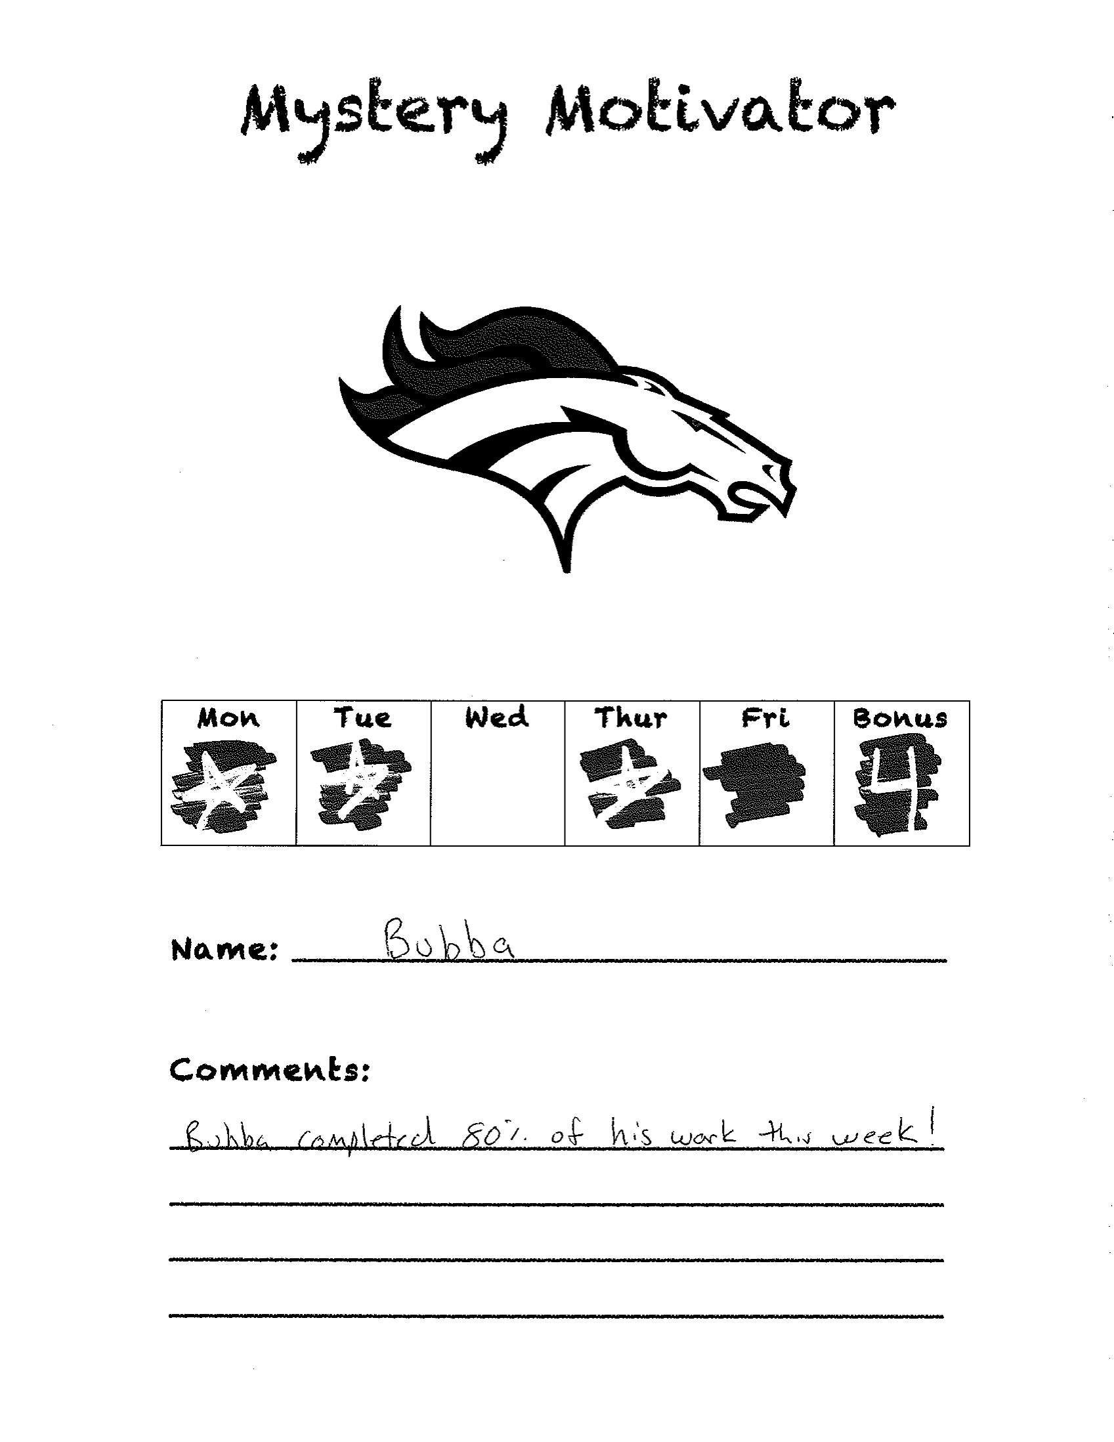
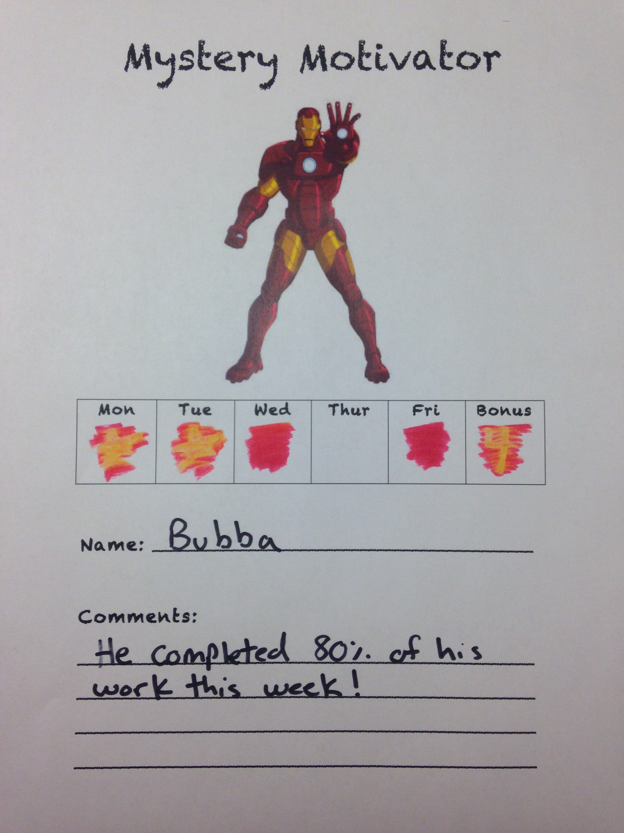
Mystery Motivators –Revisited
The Mystery Motivator can also be used as a Home Note

Slide 65
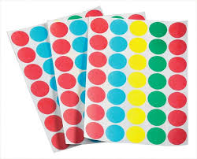
Dots for motivation
Dots for motivation is a program to increase work completion
It can be used for a class-wide program or with an individual student.
Items Needed:
Envelopes
Colored dot stickers
Goal

Slide 66
Dots for motivation
Ways a teacher can choose to give out dots: The criteria for earning dots should be decided upon before they are distributed.
On-task Behavior or rule following behavior
Each time a student competes a set number of problems
Example: 1 dot for every 4 problems
Complete assignments

Slide 67
Dots for motivation
Variations of the Dots for Motivation Program:
Dots can be cut in half. Both halves must be used
Different colored dots can be used for different subjects
Green for math, red for science, blue for spelling etc.
Multiple dots can be required to skip longer problems or test questions
Special stickers other than dots can be used
Dots can be saved for use on a later assignments
Dots can be traded in for an item on the reward menu

Slide 68
Dots for motivation
Troubleshooting:
The teacher may need to initial each dot, to prevent older students from buying their own.
Rules may also need to be established about not giving/trading or taking dots from other students.

Slide 69
References
American Psychiatric Association. (2013). Diagnostic and Statistical manual of mental disorders (5th ed.). Washington, DC: Author.
Bowen, J., Jenson, W.R., & Clark, E. (2004). School based interventions for students with behavior problems. New York, NY: Springer.
Ducharme, J.M., & Shecter, C. (2011). Bridging the gap between clinical and classroom intervention: Keystone approaches for students with challenging behavior. School Psychology Review, 40(2), 257-274.
Hepworth Neville, M., & Jenson, W.R. Effective Parent Training. Available at Jordan Family Education Center.
Jenson, W. R., Rhode, G., Reavis, H. K. (2009). The tough kid tool box. Eugene, OR: Pacific Northwest.
Rathvon, N. (2003). Effective school interventions: Strategies for enhancing academic achievement and social competence. New York, NY: The Guilford Press.
Reavis, K.H., Kukic, S.J., Jenson, W.R., Morgan, D.P., Andrews, D.P., & Fister, S.F. (1996). Best practices: Behavioral and educational strategies for teachers. Longmont, CO: Sopris West.
Rhode, G., Jenson, W.R., & Morgan, D.P. (2009). The tough kid new teacher book. Eugene, OR: Pacific Northwest.
Rhode, G., Jenson, W.R., & Reavis, K. (2010). The tough kid book: Practical classroom strategies, 2nd ed. Eugene, OR: Pacific Northwest.
Sprick, R S. (2006). Discipline in the secondary classroom: A positive approach to behavior management, 2nd ed. San Francisco, CA: Jossey-Bass.
Utah State Office of Education. (2015). Least restrictive behavioral Interventions technical assistance manual. Retrieved from http://www.schools.utah.gov/sars/Behavior.aspx
Witt, J. C., VanDerHeyden, A. M., Gilbertson, D. (2004). Troubleshooting behavioral interventions: A systematic process for finding and eliminating problems. School Psychology Review, 33, 363-381.

